Slide 1







Identifying Future Skill requirements
Tireni
28/07/24

Slide 2



OUTLINE
Executive Summary
Introduction
Methodology
Results
Visualization – Charts
Dashboard
Discussion
Findings & Implications
Conclusion
Appendix

Slide 3

EXECUTIVE SUMMARY
Data taken from online sources and was then cleaned, analyzed and presented on a dashboard.
Programming Languages:
Java still likely to be the most popular language
Html/css likely to still be very relevant in the future
Likely future demand for python & type script
Databases:
Mysql , sqlite and other top databases unlikely to keep their current demand/popularity

Slide 4

INTRODUCTION
In order to keep pace with changing technologies & remain completive, the firm must make sure that it’s staff still have the required skills that will be in demand in the future.
To accomplish this, it’s important to analyze trends from:
Surveys
Job postings
Training Portals
So that we can identify what skills are likely to be in demand for:
Languages
Databases

Slide 5

METHODOLOGY
Data Collection:
Collected from a survey, job postings & training portals via web scraping & apis
Data Wrangling
Finding & removing duplicates
Inputting missing values
Normalizing data
Expletory Data Analysis
Determining data distribution
Finding & removing outliers
Finding correlation
Data Visualization
Google Looker Studio Dashboard

Slide 6
RESULTS

Slide 7
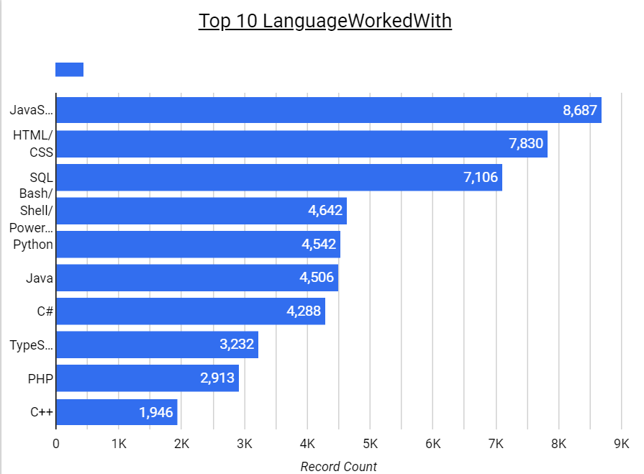
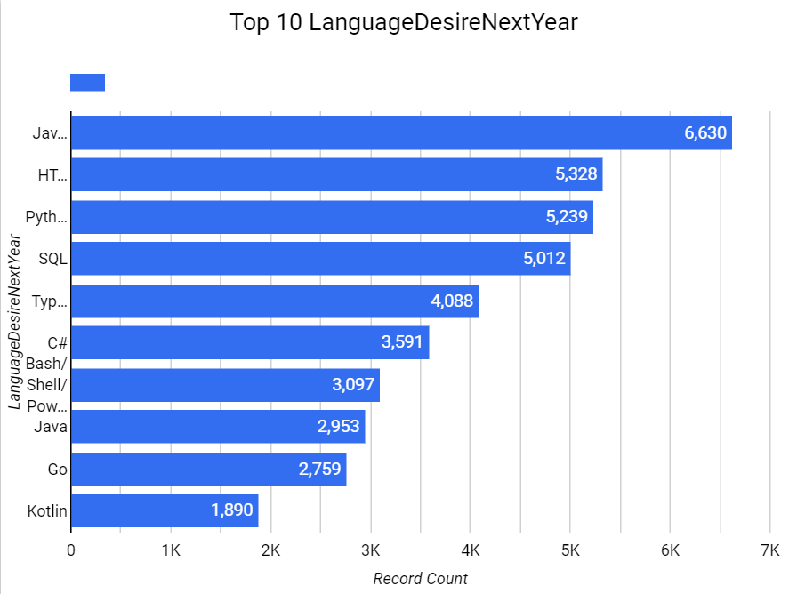
PROGRAMMING LANGUAGE TRENDS
Current Year
Next Year

Slide 8
PROGRAMMING LANGUAGE TRENDS - FINDINGS & IMPLICATIONS
Findings
Python jumped from 6th to 3rd nearly overtaking html/CSS
Type script jumped from 8th to 5th
Java and html/CSS both retain their positions within the top 2, although java is clearly more dominant
Bash/Shell/PowerShell dropped down to 7th from 4th
Implications
JavaScript is still the most popular language ,however html/css may get overtaken by python
The demand for user’s experienced with python is increasing significantly.
While not as significant as python the demand for type script is increasing
The need to learn bash/shell/PowerShell is decreasing

Slide 9
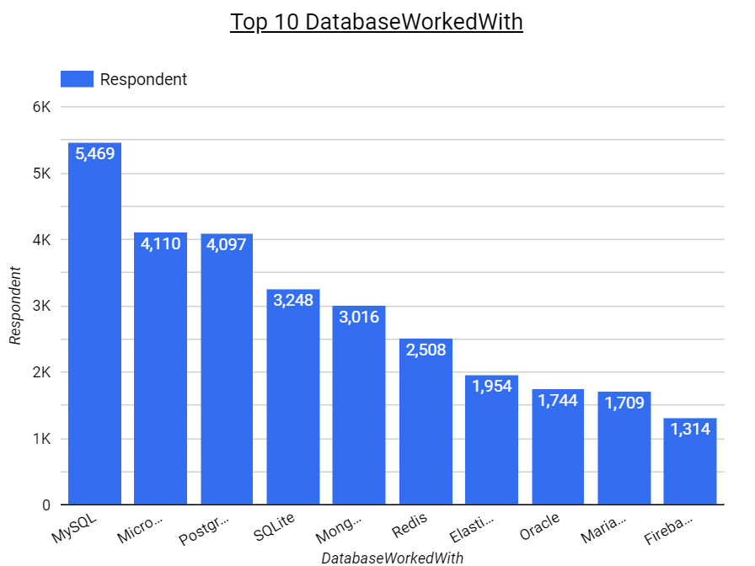
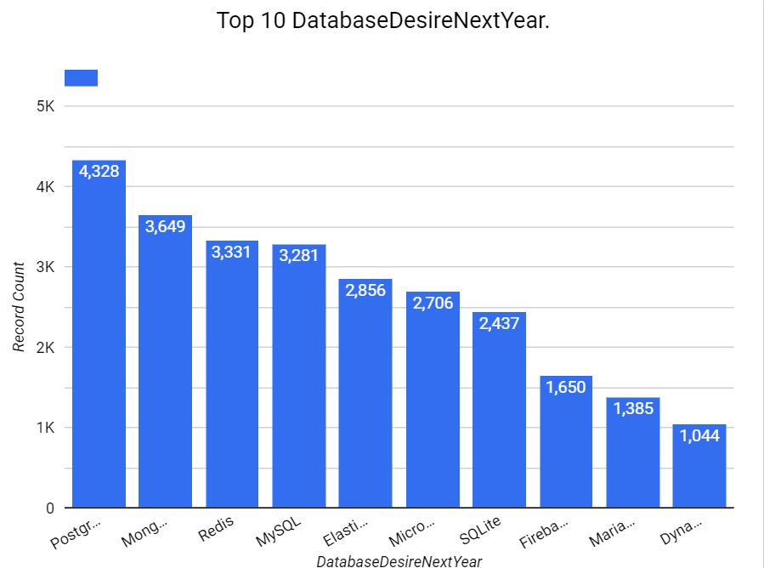
DATABASE TRENDS
Current Year
Next Year

Slide 10
DATABASE TRENDS - FINDINGS & IMPLICATIONS
Findings
Significant decrease in demand for mysql & sqlite
Mysql is currently the most used database
Significant increase in demand for postgre,mongoDB and redis
Implications
Overall database trend shows that the current popular databases may lose their standing due to interest going elsewhere

Slide 11

DASHBOARD
https://lookerstudio.google.com/reporting/17c757bd-e58b-47c9-b139-e1f7093b065b

Slide 12
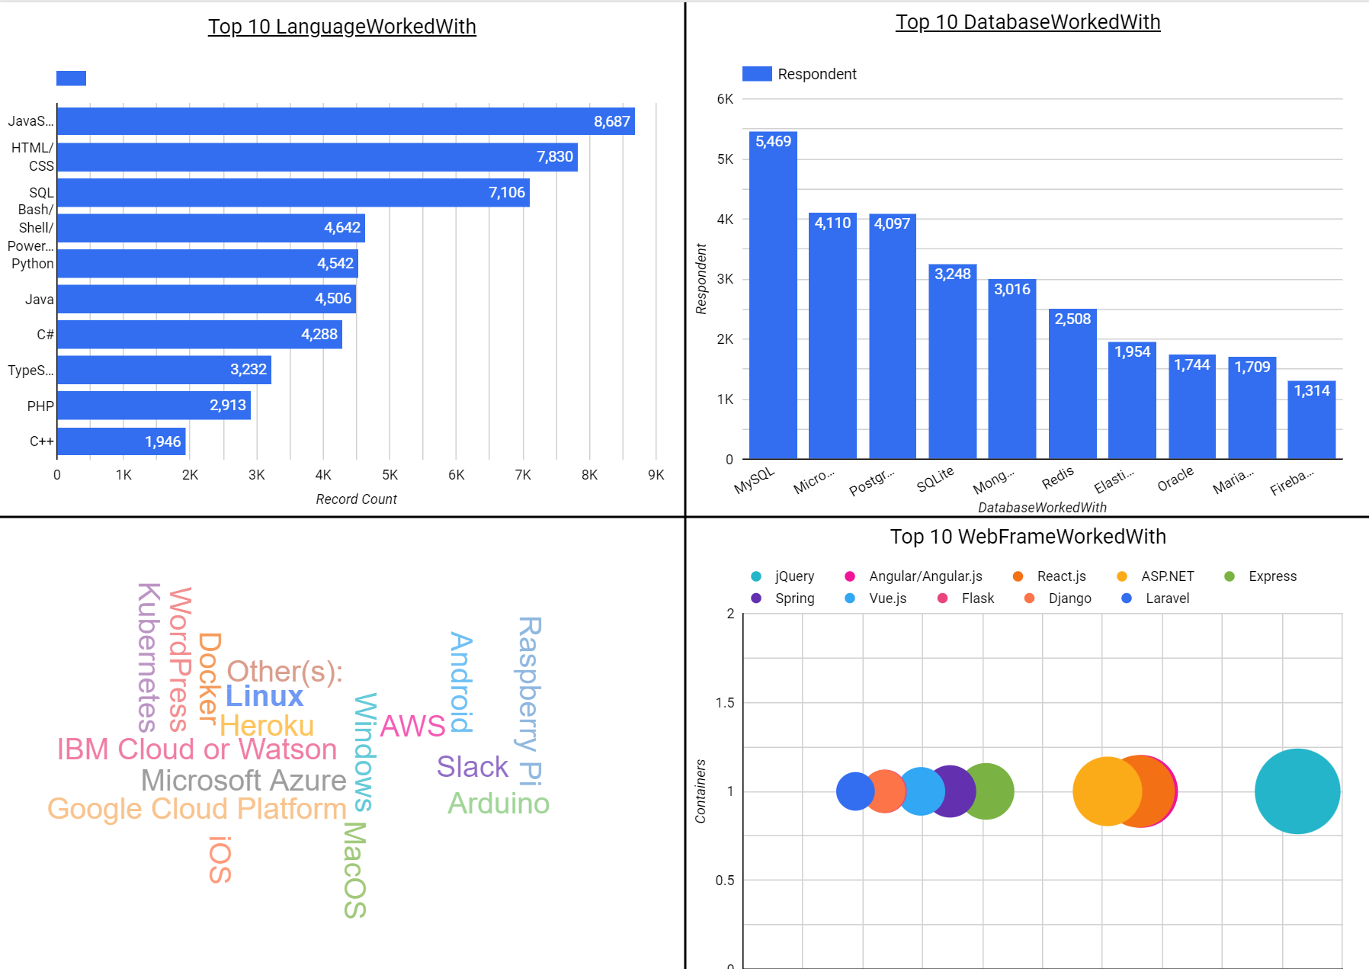
DASHBOARD TAB 1

Slide 13
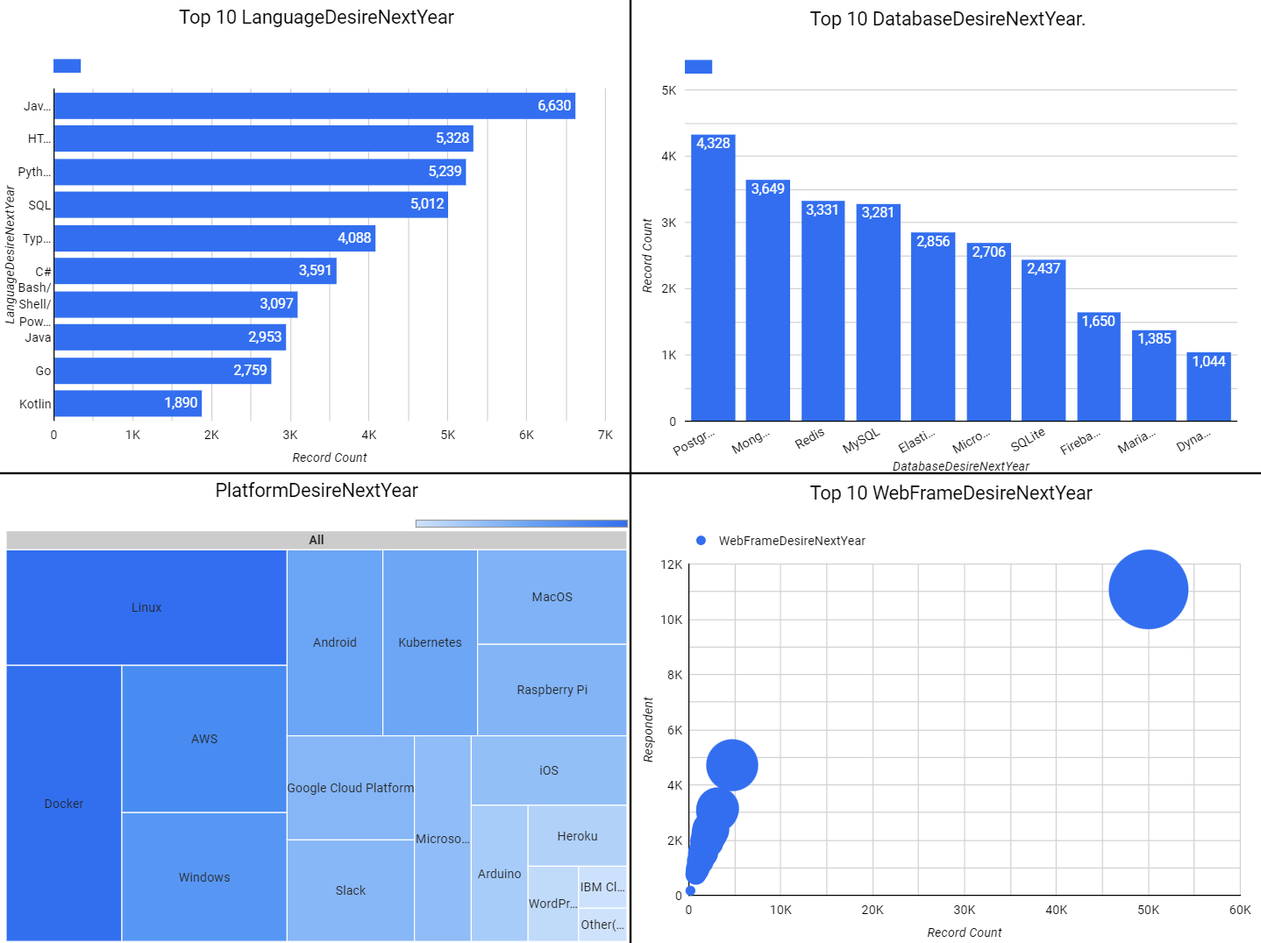
DASHBOARD TAB 2

Slide 14
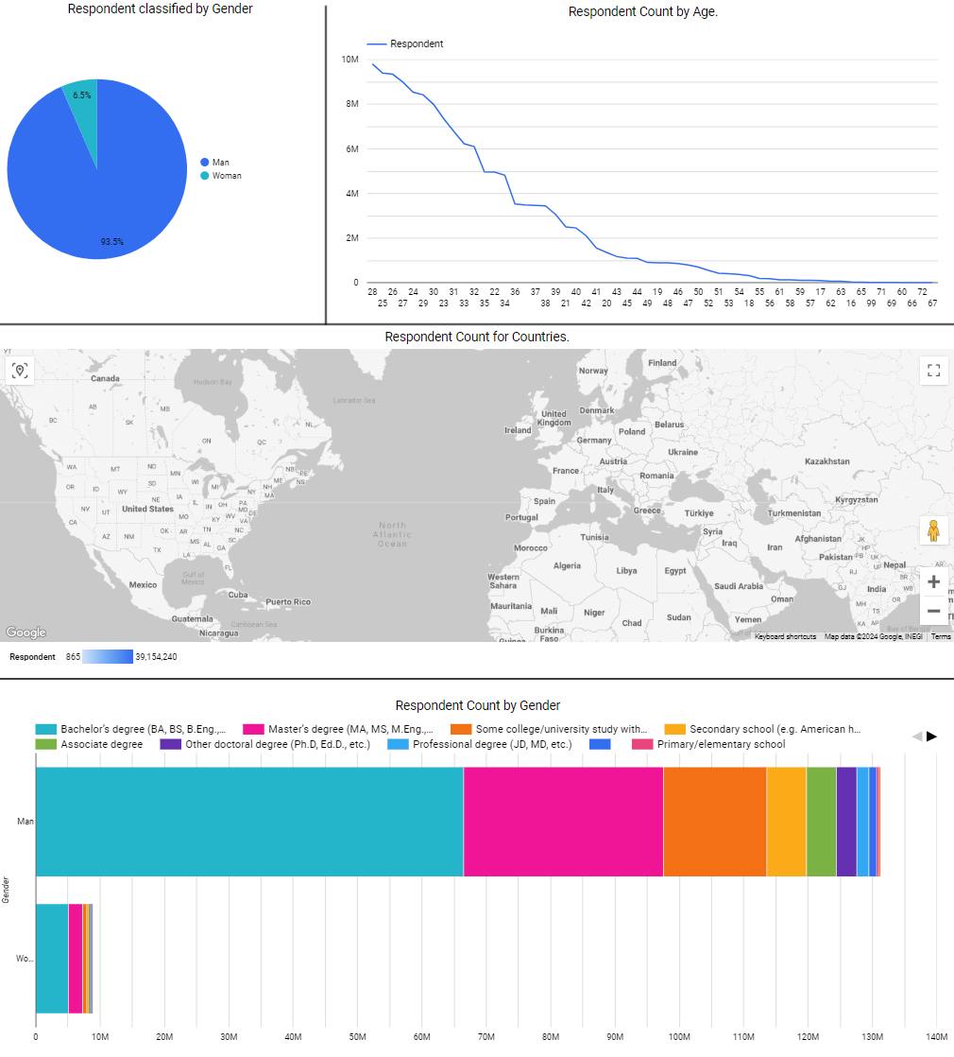
DASHBOARD TAB 3

Slide 15
DISCUSSION

Slide 16
OVERALL FINDINGS & IMPLICATIONS
Findings
Top languages seem too keep their relevancy based on interest
Top databases seem to lose their relevancy & demand based on interest
Implications
Learning current top languages like java is still viable. However, it should be noted that there’s increasing interest in the languages python & typescript
Learning current top databases might not payoff

Slide 17

CONCLUSION
For languages I’d recommend learning: java, html/CSS, python & type script
For databases I’d recommend knowing multiple as future interests seems to differ from current use

Slide 18

APPENDIX

Slide 19
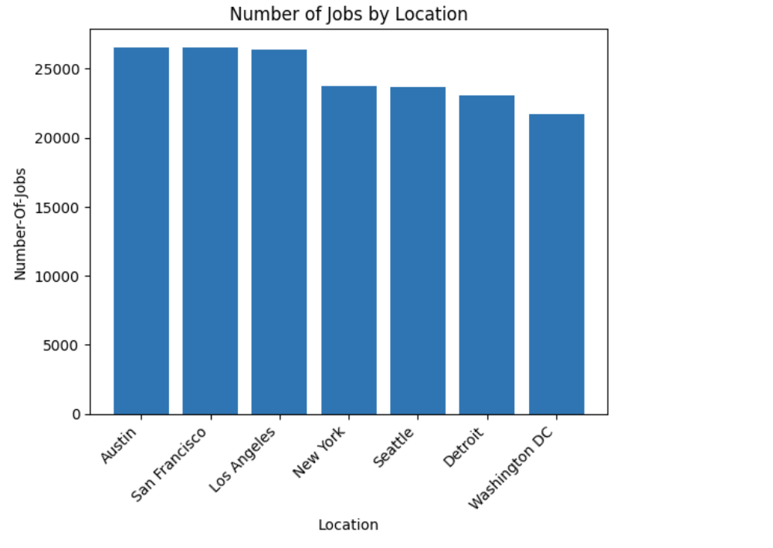
JOB POSTINGS

Slide 20
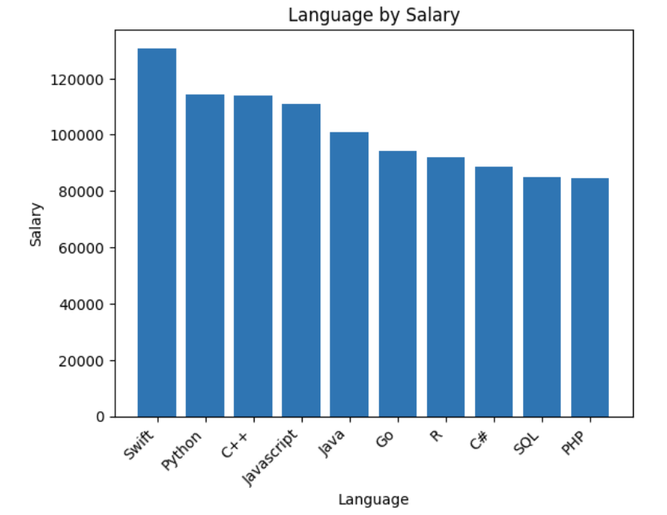
POPULAR LANGUAGES

